Slide 1
Gen AI-Based Data Profiling for Regulatory Reporting
ESSWarriors | Hackathon-2025

Slide 2
Challenge Overview
Regulatory reporting in banking requires vast data validation.
Manual data profiling is time-consuming and error-prone.
Objective: Automate data profiling using Generative AI and Unsupervised ML.
Goal: Ensure compliance by generating profiling rules, risk scores, and remediation actions.

Slide 3
Problem Statement
Develop an AI-powered data profiling solution to:
Extract & interpret regulatory reporting instructions.
Generate profiling rules using LLMs/ML.
Validate reported data using executable Python code.
Identify anomalies.
Suggest remediation with automated explanations.

Slide 4
Solution Approach
Data Extraction: Preprocess pdf files and store its content in vector store. Additionally, identify table and save each row as a document.
Profiling Rule Generation: LLM-based validation logic for each column.
Validation Engine: Python code execution based on generated for data verification.
Remediation Module: Automated suggestions for flagged transactions.
Interactive Compliance Assistant(Chat Bot): User-friendly context aware UI for auditors to chat about document and validation rules.

Slide 5
Interactive Compliance Assistant(Chat Bot)
The chatbot allows users (auditors/compliance officers) to query regulatory reporting requirements.
Workflow
User Query Input: The chatbot takes user queries related to regulatory compliance.
Server Processing: The query is sent to the backend server.
Vector Store Search: The server searches regulatory documents and historical context stored in a Vector Database.
Context Retrieval: The vector store returns relevant context.
Contextualized Query to LLM: The query, enriched with context, is sent to the LLM for response generation.
LLM Response: The AI generates a response based on both user input and retrieved context.
Output Display: The chatbot presents the answer to the user.

Slide 6
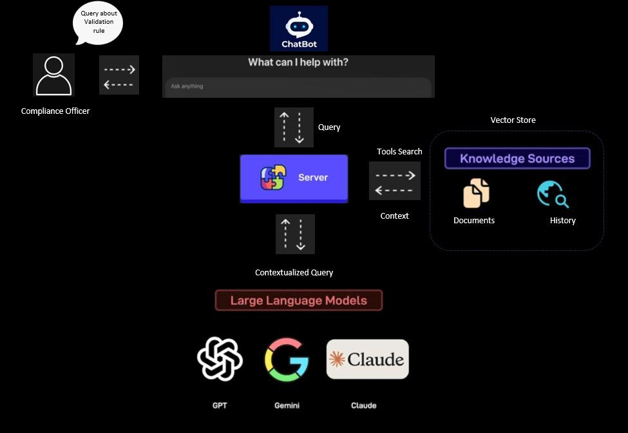
ChatBot Diagram:

Slide 7
Data Validation Workflow
User Input (CSV File):
The user uploads the dataset in CSV format for processing through UI.
Task 1: Anomaly Detection & Outlier Removal
Isolation Forest ML Algo is used to detect anomalies in the dataset.
It generates an outlier removal visualization, cleaned dataset, removed outlier dataset and outlier report.
Task 2: LLM-Powered Validation
The extracted data is sent to Program which has predefined validation functions and LLM.
Similar data fields are grouped and validation functions are created for them.
LLM searches context for data fields in regulatory documents stored in a Vector Store.
Validator Module applies predefined validation functions & extracted context to check rule compliance.
Validation Report Generation
Generates a report listing invalid rows along with relevant contextual explanations.

Slide 8
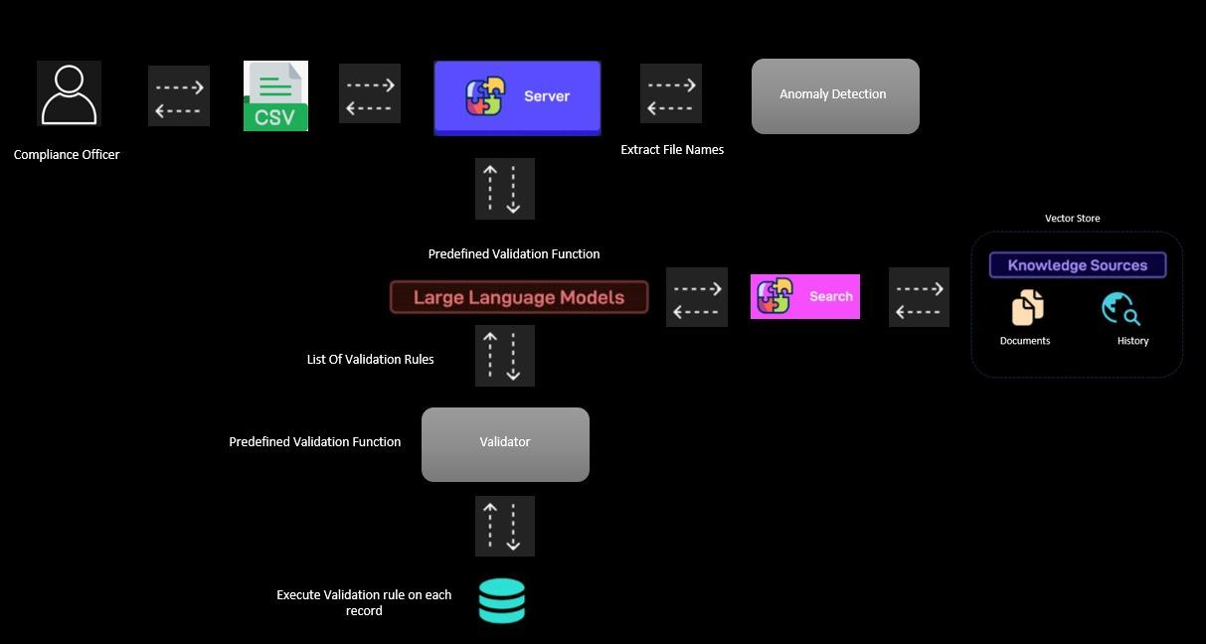
Data Validation Workflow

Slide 9
Implementation Details
Our chatbot is inspired by MemGPT where long term history is saved.
Llm calls tool to save_recall_memories which are stored in vector store
We have provided it with additional tool to search context from document which are stored in vectorstore as well as history.
After searching context when llm has sufficient information it finds the functions which should be used for validation and call corresponding tool to register it along with additional argument. For e.g a llm call range_validator tool to register range_validator function it also provides min and max value as additional argument corresponding to that column

Slide 10
Challenges Faced
LLM accuracy: Ensuring accuracy in rule extraction.
Scalability: Handling large number of column efficiently.
Unreliability of LLM output: We can’t say what is going to be its output, also unstructured output.

Slide 11
Future Enhancements
1. Generate code for new type of validations dynamically through llm.
2. Generate rules for which multiple fields are affected
3. Refining rules based on user input

Slide 12
Conclusion
AI simplifies validation rule generation
Automates repetitive rule definitions
Scales efficiently for large datasets

